Slide 1

WEB SCRAPING
DEEPIKA MANI .D
INBARASAN .S.V
KARTHICK .R
LAKSHMI NARAYANAN .T
VINEETH KUMAR .C

Slide 2
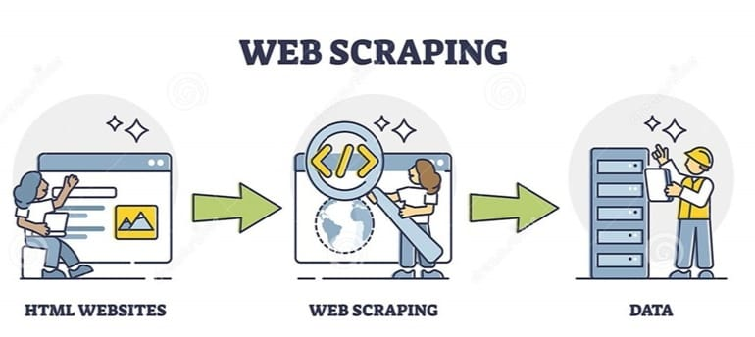
INTRODUCTION
Web Scraping is a software technique of extracting information from websites.
It focuses on transformation of unstructured data on the web (typically HTML), into structured data that can be stored and analyzed.
The Python community has come up with some pretty powerful web scraping tools.
Web Scraping also known as Web harvesting and Web Data Extraction.

Slide 3
Modules and Packages
Modules refer to a file containing Python statements and definitions. A file containing Python
code, for example: example.py , is called a module.
A package is a directory of Python modules that contains an additional __init__.py file, which
distinguishes a package from a directory that is supposed to contain multiple Python scripts.
Here, we use Requests , BeautifulSoup and subprocess modules to develop web scraping in Python.
Beautifulsoup:
Beautiful Soup is a Python library for pulling data out of HTML and XML files and used for scraping data through python.
Requests:
First, you’ll want to get the site’s HTML code into your Python script so that you can interact with it. For this task, you’ll use Python’s requests library.
Subprocess:
Subprocess in Python is a module used to run new codes and applications by creating new processes

Slide 4
requests.get
The requests library will make a GET request to a web server, which will download the HTML contents of a given web page for us.
There are several different types of requests we can make using requests, of which GET is just one.
The GET method returns data of the requested url. Suppose we want to fetch the HTML page content of a job search portal using requests get method.
.text
Fetch the raw HTML content from the URL.
html.parser
Parsing means analyzing and converting a program into an internal format that a runtime environment can actually run.

Slide 5
Headers User-Agent
The HTTP headers User-Agent is a request header that allows a characteristic string that allows network protocol peers to identify the Operating System and Browser of the web-server. Your browser sends the user agent to every website you connect to.
find
The findAll() method scans the entire document looking for results, but sometimes you only want to find one result. If you know a document only has one <body> tag, it’s a waste of time to scan the entire document looking for more.
you can use the find() method.
findAll
If we want to extract a single tag, we can instead use the find_all method, which will find all the instances of a tag on a page.
Note that findAll returns a list.
close()
This method closes an file which is currently in an open state.

Slide 6
strip
The strip() method removes any leading (spaces at the beginning) and trailing (spaces at the end) characters (space is the default leading character to remove).
index
The index() in Python returns the position of the element in the specified list or the characters in the string.
open
This function is used to opens a file, and returns it as a file object.
Popen
It creates a pipe between the calling program and the executed command, and returns a pointer to a stream that can be used to either read from or write to the pipe.
Write
Opens a file for writing , creates a file if it does not exist.

Slide 7
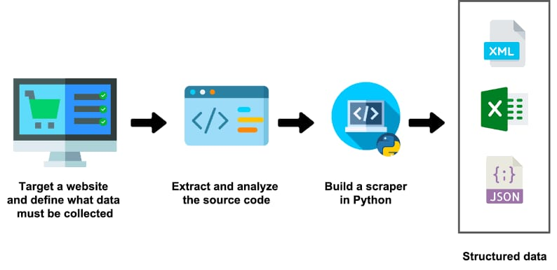

Slide 8
Flow Diagram
Start
Open the web browser
Go to the website source page
Analyze website source script
Analyze the pattern
No
Is there any specific pattern?
Process it to structured data and stored it in a required format
End
Yes

Slide 9
ALGORITHM
Step1:Start
Step2:Open PyCharm IDE.
Step3:Import Python library.
from bs4 import BeautifulSoup
import requests
import subprocess
Step4:Get the URL from web browser.
Step5:Get the raw html codes from the web page by selecting the inspect or view page source.
Step6:Get the contents based on Tags and class from the html code.
Step7:Remove unwanted text from the html code using split function and append the texts required into a new list.
Step8:Since removing a explanation part from the String removes the code snippets, The new list with only code snippets is created.

Slide 10
Step8 :Give condition to concat code with question.
Step9 :Remove empty index in question list.
Step10:Add the code part with question list.
Step11:Using file handling store the file as text format.
Step12:Open the notepad to view the output.

Slide 11
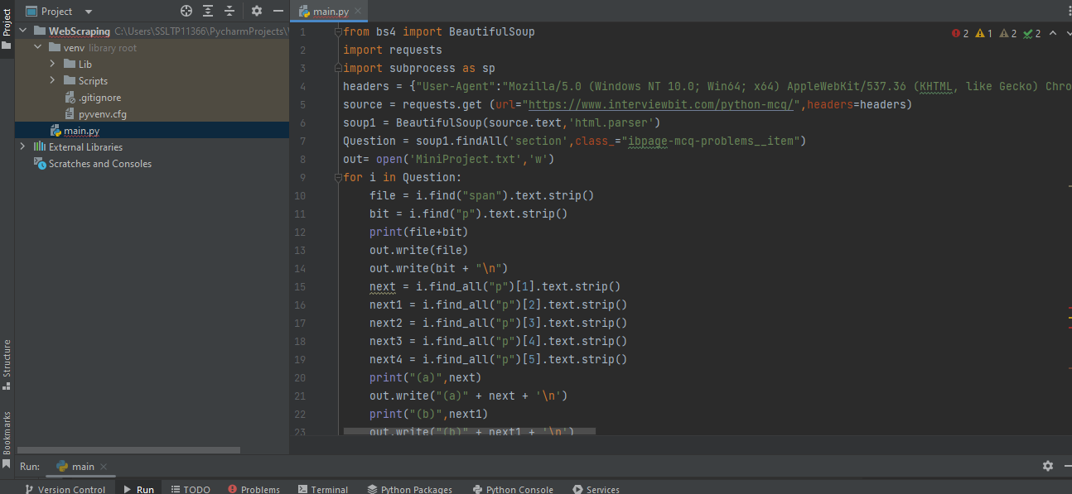
SAMPLE SNIPPET

Slide 12
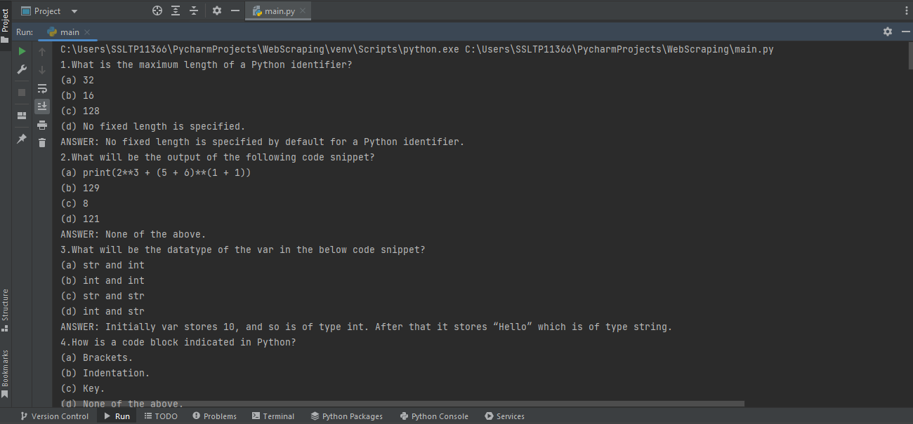
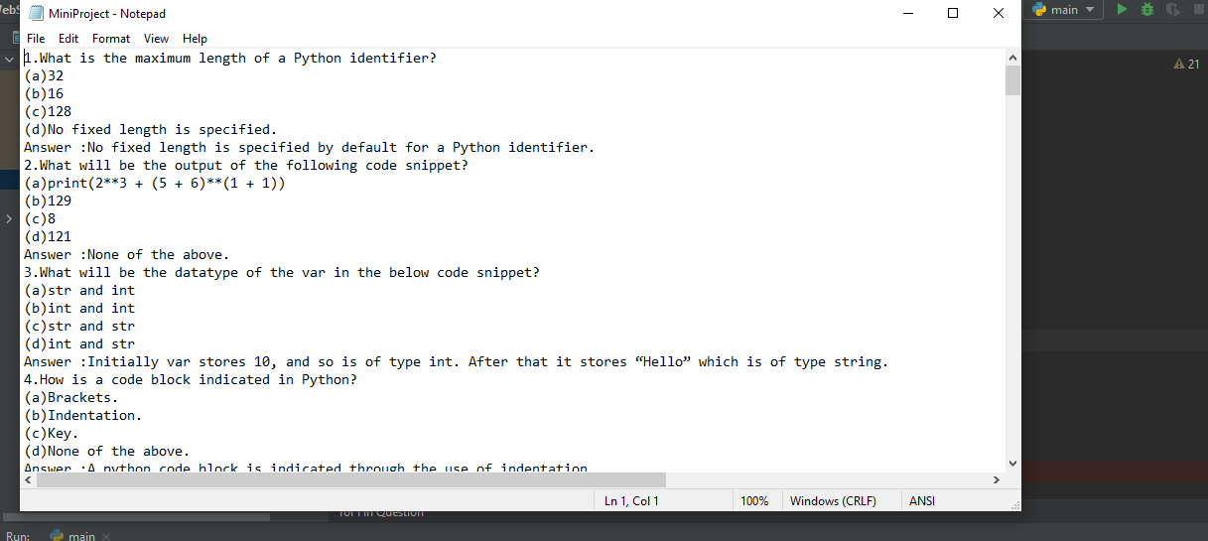
OUTPUT

Slide 13
CONCULSION:
All our needs in this project to be executed successfully
our target to get all 50 text questions to be retrieved from the above mentioned web URL
And it should be saved in a notepad as automated. Although it’s possible to parse data from the Web using tools in Python’s standard library, there are many tools on PyCharm using python that can help simplify the process.
In this mini project ,we learned how to:
Request a web page using Python’s built-in urllib module. Parse HTML using Beautiful Soup. Interact with web URL using BeatifulSoup.Repeatedly request data from a website to check for updates.

